Slide 1
Input Output Interface
CO
‹#›

Slide 2
Topics
I/O Devices
I/O Device System Issues
Storage Devices
Buses
I/O Interfaces
‹#›

Slide 3
I/O Devices
Many tasks involve reading and processing enormous quantities of data
Institutions like banks and airlines have huge databases that must be constantly accessed and updated
Celera Genomics is a company that sequences genomes, with the help of computers and 100 trillion bytes of storage!
I/O is important for us small people too
People use home computers to edit movies and music
Large software packages may come on multiple compact discs
Everybody surf the web!
‹#›

Slide 4
I/O Devices
Computers communicate with the outside world via I/O devices
Input devices supply computers with data to operate on
Results of computations can be sent to output devices
‹#›

Slide 5
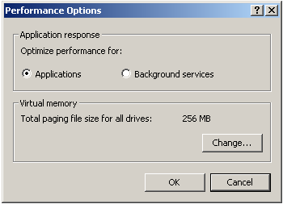
Common I/O devices
Hard drives are a necessity, so their speed has a big impact on system performance
Store all the programs, movies and assignments you crave
Virtual memory systems let a HD act as a large (but slow) part of main memory
Networks are also required
Give you access to data from around the world
HDs can act as a cache for network data
For example, web browsers often store local copies of recently viewed web pages
‹#›

Slide 6
I/O Device System
I/O Device System Issues
How I/O devices are connected by buses
I/O performance affects the overall system speed
Speed of typical I/O device to supply data to a computer
LAN speeds go up to 100 Mbit/s, which is about 12.5MB/s
HDs provide a lot of storage and transfer speeds around 40-60MB per second
Very slow compared to modern processors and memory systems:
Modern CPUs can execute more than a billion instructions per second
Modern memory systems can provide 2-4 GB/s bandwidth
I/O performance has not increased as quickly as CPU performance, partially due to neglect and partially to physical limitations
This is changing, with faster networks, better I/O buses, RAID drive arrays, and other new technologies
‹#›

Slide 7
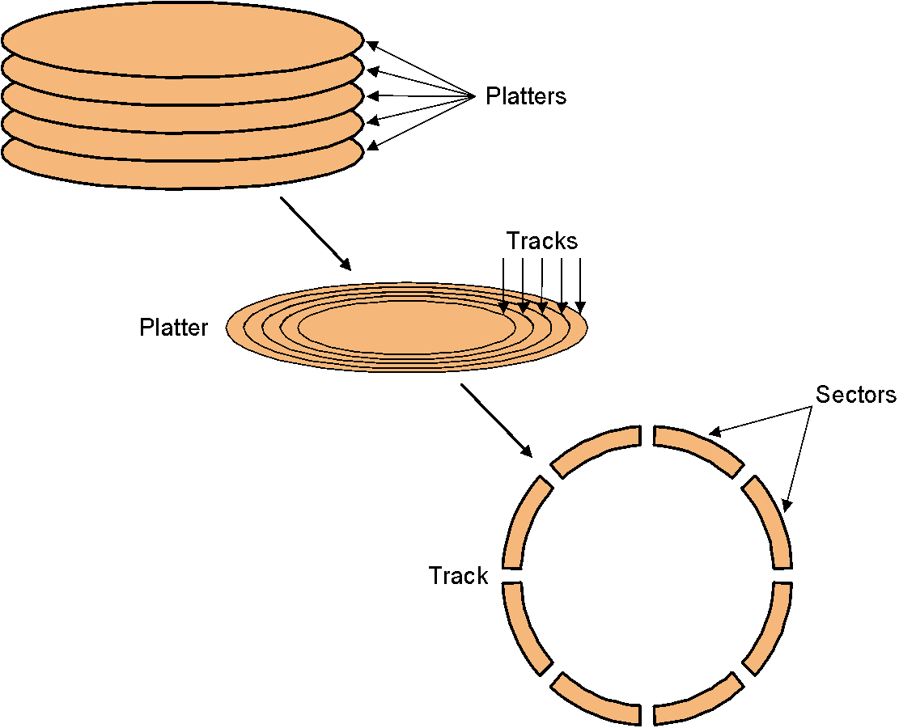
Hard drives
Hard disk
Data is stored on double-sided magnetic disks called platters
Each platter is arranged like a record, with many concentric tracks
Tracks are further divided into individual sectors, which are the basic unit of data transfer
Each surface has a read/write head like the arm on a record player, but all the heads are connected and move together
A 75GB IBM Deskstar has roughly:
5 platters (10 surfaces),
27,000 tracks per surface,
512 sectors per track, and
512 bytes per sector
‹#›

Slide 8
Accessing data on a hard disk
Access of sector on a track on a hard disk takes a lot of time
Seek time measures the delay for the disk head to reach the track
Rotational delay accounts for the time to get to the right sector
Transfer time is how long the actual data read or write takes
There may be additional overhead for the operating system or the controller hardware on the hard disk drive
Rotational speed, measured in revolutions per minute or RPM, partially determines the rotational delay and transfer time
T
r
a
c
k
s
P
l
a
t
t
e
r
S
e
c
t
o
r
s
T
r
a
c
k
‹#›

Slide 9
Estimating disk latencies (seek time)
Manufacturers often report average seek times of 8-10ms
These times average the time to seek from any track to any other track
In practice, seek times are often much better
For example, if the head is already on or near the desired track, then seek time is much smaller. In other words, locality is important!
Actual average seek times are often just 2-3ms
‹#›

Slide 10
Estimating Disk Latencies (Rotational Latency)
Once the head is in place, we need to wait until the right sector is underneath the head
This may require as little as no time (reading consecutive sectors) or as much as a full rotation (just missed it)
On average, for random reads/writes, we can assume that the disk spins halfway on average
Rotational delay depends partly on how fast the disk platters spin.
Average rotational delay = 0.5 x rotations x rotational speed
For example, a 5400 RPM disk has an average rotational delay of:
= 0.5 rotations / (5400 rotations/minute)
= 0.5 rotations / (5400 rotations/60 seconds)
= 5.55ms
‹#›

Slide 11
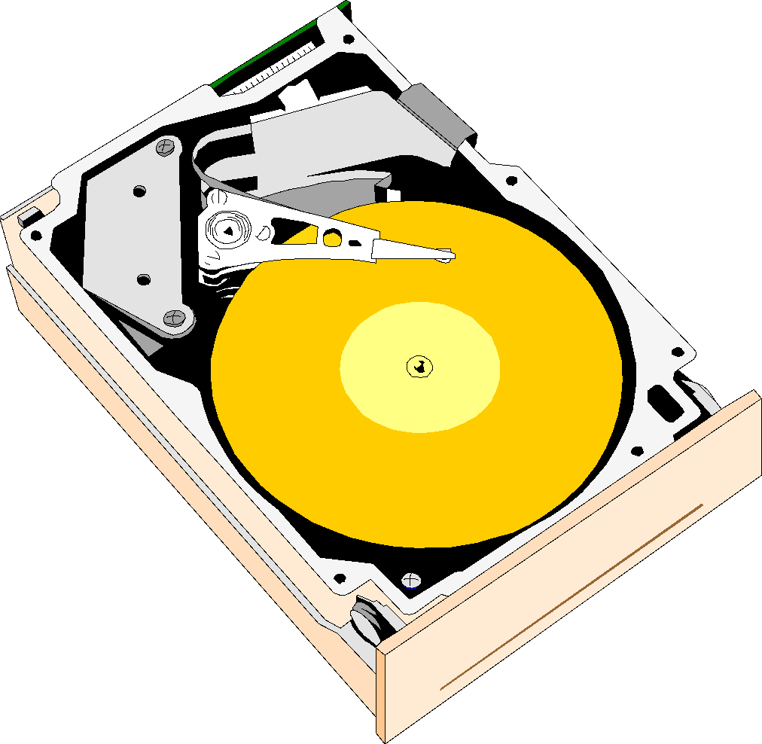
Estimating disk times
The overall response time is the sum of the seek
time, rotational delay, transfer time, and overhead
Assume a disk has the following specifications
An average seek time of 9ms
A 5400 RPM rotational speed
A 10MB/s average transfer rate
2ms of overheads
How long does it take to read a random 1,024 byte sector?
The average rotational delay is 5.55ms
The transfer time will be about (1024 bytes / 10 MB/s) = 0.1ms
The response time is then 9ms + 5.55ms + 0.1ms + 2ms = 16.7ms
That means 16,700,000 cycles for a 1GHz processor!
One possible measure of throughput would be the number of random sectors that can be read in one second
(1 sector / 16.7ms) x (1000ms / 1s) = 60 sectors/second
‹#›

Slide 12
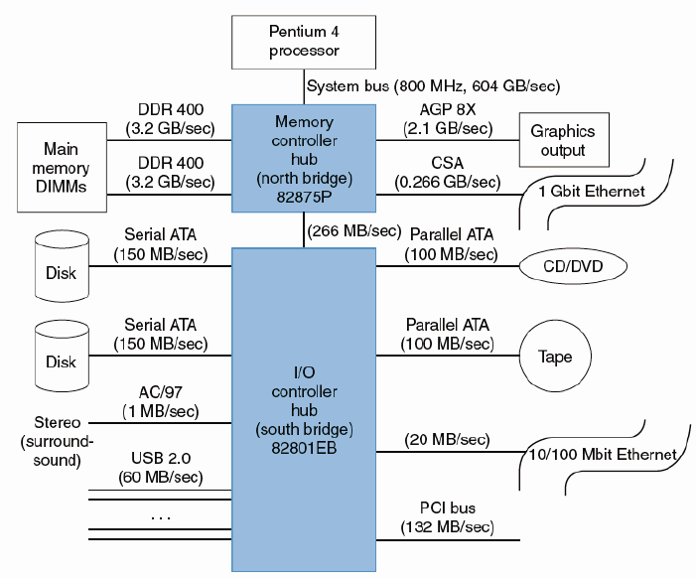
Bus/Network of Pentium 4 Processor
‹#›

Slide 13
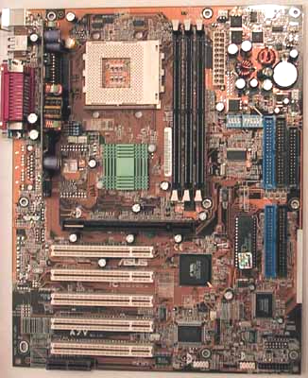
The Hardware (The Motherboard)
CPU socket
Serial,
parallel,
and USB
ports
Memory slots
IDE drive
connectors
(Back)
(Front)
AGP slot
PCI slots
‹#›

Slide 14
The Hardware (The Motherboard)
Different motherboards support different CPUs, types of memories, and expansion options
The picture is of an Asus motherboard
CPU socket supports AMD Duron and Athlon processors
Three main Memory (Dual In-line Memory Module-DIMM) slots for standard PC100 memory Using 512MB DIMMs, you can get up to 1.5GB of main memory
AGP slot is for video cards, which generate and send images from the PC to a monitor
IDE ports connect internal storage devices like hard drives, CD-ROMs, and Zip drives
PCI slots hold other internal devices such as network and sound cards and modems
Serial, parallel and USB ports are used to attach external devices such as scanners and printers
‹#›

Slide 15
How is it all connected?
CPU
Memory
North Bridge
chip
AGP
port
Video
card
PCI bus
South Bridge
chip
PCI slots
Modem
Sound card
IDE controller
Serial, parallel
and USB ports
Hard disks
CD-ROM
‹#›

Slide 16
PCI
Peripheral Component Interconnect
A synchronous 32-bit bus running at 33MHz, although it can be extended to 64 bits and 66MHz
The maximum bandwidth is about 132 MB/s
33 million transfers/second x 4 bytes/transfer = 132MB/s
Cards in the motherboard PCI slots plug directly into the PCI bus
Devices made for the older and slower ISA bus standard are connected via a “south bridge” controller chip, in a hierarchical manner
North Bridge
chip
33 MHz PCI bus
South Bridge
chip
PCI slots
‹#›

Slide 17
Frequencies
CPUs actually operate at two frequencies.
Internal frequency
The clock rate inside the CPU, which is what we’ve been talking about so far
External frequency
The speed of the processor bus, which limits how fast the CPU can transfer data
The internal frequency is usually a multiple of the external bus speed
A 2.167 GHz Athlon XP sits on a 166 MHz bus (166 x 13)
A 2.66 GHz Pentium 4 might use a 133 MHz bus (133 x 20)
You may have seen the Pentium 4’s bus speed quoted at 533MHz. This is because the Pentium 4’s bus is “quad-pumped”, so that it transfers 4 data items every clock cycle.
Processor and Memory data rates far exceed PCI’s capabilities:
With an 8-byte wide “533 MHz” bus, the Pentium 4 achieves 4.3GB/s
A bank of 166MHz Double Data Rate (DDR-333) Memory achieves 2.7GB/s
‹#›

Slide 18
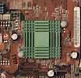
The North Bridge
To achieve the necessary bandwidths, a “frontside bus” is often dedicated to the CPU and main memory.
“bus” is actually a bit of a misnomer as, in most systems, the interconnect consists of point-to-point links.
The video card, which also need significant bandwidth, is also given a direct link to memory via the Accelerated Graphics Port (AGP).
All this CPU-memory traffic goes through the “north bridge” controller, which can get very hot (hence the little green heatsink)
CPU
Memory
64
North Bridge
chip
32
AGP
port
Video
card
2.7GB/s @ 133MHz
1.1GB/s @ 133MHz x 2
‹#›

Slide 19


External buses
External buses are provided to support the frequent plugging and un-plugging of devices
As a result their designs significantly differ from internal buses
Two modern external buses, Universal Serial Bus (USB) and FireWire
FireWire - Fast method to transfer information between digital devices, especially audio and video equipment in older external hard drives and digital cameras
Have the following (desirable) characteristics:
Plug-and-play standards allow devices to be configured with software, instead of flipping switches or setting jumpers
Hot plugging means that you don’t have to turn off a machine to add or remove a peripheral
The cable transmits power! No more power cables or extension cords.
Serial links are used, so the cable and connectors are small
‹#›

Slide 20
Bus
Every computer has several small “networks” inside, called buses, to connect processors, memory, and I/O devices
A bus is just a bunch of wires which transmits three kinds of information
Control signals specify commands like “read” or “write”
The location on the device to read or write is the address
Finally, there is also the actual data being transferred
Some buses include separate control, address and data lines, so all of this information can be sent in one clock cycle
Control
Address
Data
CPU
Memory
Hard disks
CD-ROM
Network
Display
‹#›

Slide 21
Buses/Networks
Bus transactions
Read (output): Memory to I/O device
Write (input): I/O device to memory
‹#›

Slide 22
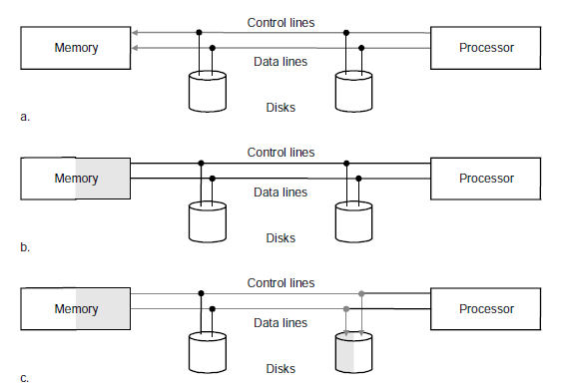
Bus Transactions
Output: Memory to I/O device
Request a read on control lines and supply data at the data lines
Memory access
Memory signals data availability and transfer them on the data line to I/O
‹#›

Slide 23
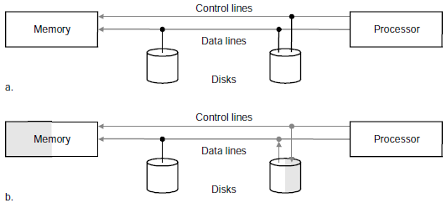
Bus Transactions
Input: I/O device to memory
Write request for memory on the control lines and address on the data lines
Memory signal the I/O device that is ready and transfers starts
‹#›

Slide 24
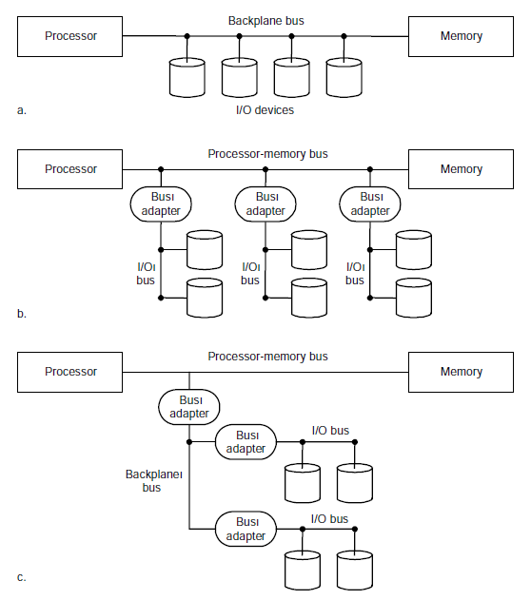
Buses/Networks
Types of buses
Processor-memory (specific)
I/O buses (standard)
Backplane bases (standard)
‹#›

Slide 25
Types of Buses
Processor-Memory bus
Connects processor and memory
Short, high speed and matched to the memory system to maximize memory-processor bandwidth
I/O bus
Connects devices to the processor
Lengthy, wide range in the data bandwidth
Do not interface directly to the memory but use either a processor-memory or a backplane bus to connect to memory
Standards: USB and Firewire
To connect variety of devices to the desktop computer from keyboard to cameras to disks
Backplane bus
Designed to allow processors, memory and I/o devices to coexist on a single bus
‹#›

Slide 26
Types of Buses as per Connection
The simplest kind of bus is linear, as shown here
All devices share the same bus
Only one device at a time may transfer data on the bus
Simple is not always good
With many devices, there might be a lot of contention
The distance from one end of the bus to the other may also be relatively long, increasing latencies
System bus
CPU
Memory
Hard disks
CD-ROM
Network
Display
‹#›

Slide 27
Types of Buses as per Connection
Hierarchical buses
Bus can split into different segments
Since the CPU and memory need to communicate so often, a shorter and faster processor-memory bus can be dedicated to them
A separate I/O bus would connect the slower devices to each other, and eventually to the processor
CPU
Memory
Processor-memory bus
I/O bus
Hard disks
CD-ROM
Network
Display
‹#›

Slide 28
Basic bus protocols
Although physically, our computer may have a hierarchy of buses (for performance), logically it behaves like a single bus
Two devices might interact as follows:
1. An initiator sends an address and data over the bus to a target
2. The target processes the request by “reading” or “writing” data
3. The target sends a reply over the bus back to the initiator
The bus width limits the number of bits transferred per cycle
System bus
(1)
(3)
CPU
Memory
Hard disks
CD-ROM
Network
Display
(2)
‹#›

Slide 29
Multiplexed bus lines
Unfortunately, this could lead to many wires and wires cost money
Many buses transfer 32 to 64 bits of data at a time
Addresses are usually at least 32-bits long
Another common approach is to multiplex some lines
For example, we can use the same lines to send both the address and the data, one after the other
The drawback is that now it takes two cycles to transmit both pieces of information
Control
Address
& Data
CPU
Memory
Hard disks
CD-ROM
Network
Display
‹#›

Slide 30
Types of Buses for Communication
Synchronous bus
Operates with a central clock signal
Bus transactions can be handled easily with finite state machines
However, the clock rate and bus length are inversely proportional; faster clocks mean less time for data to travel
This is one reason why PCs never have more than about five expansion slots
All devices on the bus must run at the same speed, even if they are capable of going faster
Asynchronous bus
Does not rely on clock signals
Bus transactions rely on complicated handshaking protocols so each device can determine when other ones are available or ready
On the other hand, the bus can be longer and individual devices can operate at different speeds
Many external buses like USB and Firewire are asynchronous
‹#›

Slide 31
Serial/Parallel
Bus organization
Serial vs. Parallel
Modern external buses serial rather than parallel
Generally, more wires would increase bandwidth and reduce latency, but, if they can be clocked at comparable frequencies
Two physical issues allow serial links to be clocked significantly faster:
On parallel interconnects, interference between the signal wires becomes a serious issue
Skew is also a problem; all of the bits in a parallel transfer could arrive at slightly different times
Serial links are being increasingly considered for internal buses:
Serial ATA is a new standard for hard drive interconnects
PCI-Express (aka 3GI/O) is a PCI bus replacement that uses serial links
‹#›

Slide 32
I/O Interface
Most I/O requests
Made by applications or the operating system
Involve moving data between a peripheral device and main memory
Two main ways that programs communicate with devices
Memory-mapped I/O
Isolated I/O
‹#›

Slide 33
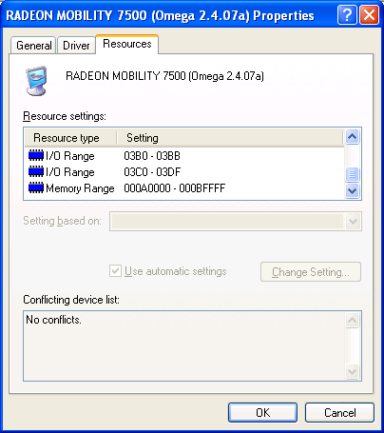
Communicating with devices
Most devices can be considered as memories, with an “address” for reading or writing
Many instruction sets often make this analogy explicit
To transfer data to or from a particular device, the CPU
can access special addresses
A video card can be accessed via addresses 3B0-3BB, 3C0-3DF and A0000-BFFFF
There are two ways these addresses can be accessed
‹#›

Slide 34
Memory-mapped I/O
Memory
FFFF
One address space is divided into two parts
Some addresses refer to physical memory locations
Other addresses actually reference peripherals
For example, a 16-bit address bus which could access a whole 64KB of memory
Addresses C000-CFFF in hexadecimal were not part of memory, but were used to access I/O devices
All the other addresses did reference main memory
The I/O addresses are shared by many peripherals, for example
C010 is attached to the keyboard, while
C030 goes to the speaker
Some devices may need several I/O addresses
D000
I/O
C000
Memory
0000
‹#›

Slide 35
Programming memory-mapped I/O
Control
Address
Data
CPU
Memory
Hard disks
CD-ROM
Network
Display
To send data to a device, the CPU writes to the appropriate I/O address
The address and data are then transmitted along the bus
Each device has to monitor the address bus to see if it is the target
For example, main memory ignores any transactions whose address begins with bits 1100 (addresses C000-CFFF)
The speaker only responds when C030 appears on the address bus
‹#›

Slide 36
Isolated I/O
Another approach is to support separate address spaces for memory and I/O devices, with special instructions that access the I/O space
For instance, 8086 machines have a 32-bit address space
Regular instructions like MOV reference RAM
The special instructions IN and OUT access a separate 64KB I/O address space
Main
memory
FFFFFFFF
00000000
I/O
devices
0000FFFF
00000000
‹#›

Slide 37
Memory-mapped Vs. Isolated I/O
Memory-mapped I/O with a single address space, the same instructions that access memory can also access I/O devices
For example, issuing MIPS sw instructions to the proper addresses can store data to an external device
With isolated I/O, special instructions are used to access devices
This is less flexible for programming
‹#›

Slide 38
I/O Interface
Several ways of managing data transfers between devices and main memory
Programmed I/O
Interrupt-driven I/O
Direct memory access
‹#›

Slide 39
Transferring data with programmed I/O
CPU sends read
request to device
Process of data is transferred between a device and memory
Under programmed I/O, it is all up to a user program or the operating system
The CPU makes a request and then waits for the device to become ready (e.g., to move the disk head)
Buses are only 32-64 bits wide, so the last few steps are repeated for large transfers
A lot of CPU time is needed for this
If the device is slow the CPU might have to wait a long time—as most devices are slow compared to modern CPUs
The CPU is also involved as a middleman for the actual data transfer
(This CPU flowchart is based on one from Computer Organization and Architecture by William Stallings.)
Not ready
CPU waits
for device
Ready
CPU reads word
from device
CPU writes word
to main memory
No
Done?
Yes
‹#›

Slide 40
CPU Waits for Device
Continually checking to see if a device is ready is called polling
Not a particularly efficient use of the CPU
The CPU repeatedly asks the device if it is ready or not?
The processor has to ask often enough to ensure that it does not miss anything, which means it cannot do much else while waiting
CPU sends read
request to device
Not ready
CPU waits
for device
Ready
‹#›

Slide 41
Interrupt-driven I/O
Interrupt-driven I/O requires knowledge of
Interrupts
Exceptions
Program them
‹#›

Slide 42
Interrupts
Interrupts are external events that require the processor’s attention
Peripherals and other I/O devices may need attention
Timer interrupts to mark the passage of time
These situations are not errors
They happen normally
All interrupts are recoverable
The interrupted program will need to be resumed after the interrupt is handled
It is the operating system’s responsibility to do the right thing, such as:
Save the current state
Find and load the correct data from the hard disk
Transfer data to/from the I/O device
‹#›

Slide 43
Exception handling
Exceptions are typically errors that are detected within the processor
The CPU tries to execute an illegal instruction opcode
An arithmetic instruction overflows, or attempts to divide by 0
The a load or store cannot complete because it is accessing a virtual address currently on disk
There are two possible ways of resolving these errors
If the error is un-recoverable, the operating system kills the program
Less serious problems can often be fixed by the O/S or the program itself
‹#›

Slide 44
How interrupts/exceptions are handled
For simplicity exceptions and interrupts are handled the same way
When an exception/interrupt occurs, we stop execution and transfer control to the operating system, which executes an “exception handler” to decide how it should be processed
The exception handler needs to know two things
The cause of the exception (e.g., overflow or illegal opcode)
What instruction was executing when the exception occurred
This helps the operating system report the error or resume the program
This is another example of interaction between software and hardware, as the cause and current instruction must be supplied to the operating system by the processor
‹#›

Slide 45
Interrupt-driven I/O
Interrupt-driven I/O attacks the problem of the processor having to wait for a slow device
Instead of waiting, the CPU continues with other calculations
The device interrupts the processor when the data is ready
The data transfer steps are still the same as with programmed I/O, and still occupy the CPU
(Flowchart based on Stallings again.)
CPU sends read
request to device
CPU does other stuff
. . .
CPU receives interrupt
CPU reads word
from device
CPU writes word
to main memory
No
Done?
Yes
‹#›

Slide 46
Direct Memory Access (DMA)
A method of data transfer
The DMA controller is a simple processor which does most of the functions that the CPU would otherwise have to handle
The CPU asks the DMA controller to transfer data between a device and main memory
After that, the CPU can continue with other tasks
The DMA controller issues requests to the right I/O device, waits, and manages the transfers between the device and main memory
Once finished, the DMA controller interrupts the CPU
(Flowchart again from William Stallings.)
CPU sends read
request to DMA
unit
CPU does other stuff
. . .
CPU receives DMA
interrupt
‹#›

Slide 47
Main memory problems
System bus
CPU &
cache
Memory
DMA unit
Hard disks
CD-ROM
Network
There are some complications with DMA
Since both the processor and the DMA controller may need to access main memory, some form of arbitration is required
If the DMA unit writes to a memory location that is also contained in the cache, the cache and memory could become inconsistent
‹#›

Slide 48
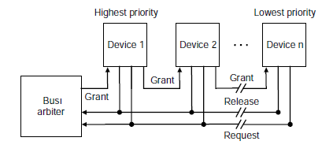
Bus Arbitration Schemes
Daisy Chain Arbitration
A single bus grant line is run through the devices from highest priority to lowest
A higher priority device intercepts the bus grant signal, not allowing a lower priority device to see it
Centralized, Parallel Arbitration
Using multiple request lines managed by a centralized arbiter
Distributed Arbitration by Self Selection
Multiple request lines, but the device requesting the bus access determine who will be granted access
Each bus requesting device places its identity code on the bus
Distributed Arbitration by Collision Detection
Each device independently requests the bus
Multiple simultaneous requests result in a collision, which is detected and solved
‹#›

Slide 49
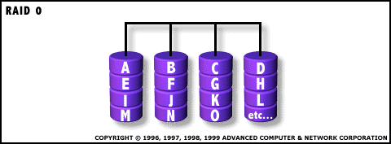
Parallel I/O
Many hardware systems use parallelism for increased speed
Pipelined processors include extra hardware so they can execute multiple instructions simultaneously
Dividing memory into banks lets us access several words at once
A Redundant Array of Inexpensive Disks (RAID) system allows access to several hard drives at once, for increased bandwidth
The following picture shows a single data file with fifteen sectors denoted A-O, which are “striped” across four disks
‹#›

Slide 50
RAID
Instead of large expensive disks, use many small disks
Performance will improve, as there will be more read heads, advantages in cost, power and floor space as more efficient per GB than larger disks
Redundancy is required because many more smaller disks had lower reliability than a few large disks
How much redundancy?
Need of extra information to find the faults?
How to organize the data?
Extra check information on these disks?
‹#›

Slide 51
RAID 0
Striping
Allocation of logically sequential blocks to separate disks to allow higher performance than a single disk can deliver
Many disks operate at once, so improves performance for large accesses
E.g. Video Editing systems
No redundancy
Widely used
‹#›

Slide 52
RAID 1 & RAID 2
RAID 1
To tolerate disk failure, use mirroring/shadowing
Writes identical data to multiple disks to increase data availability
Always two copies of the information
If a disk fails, the system just goes to the mirror and reads its contents
Most expensive RAID solution but widely used
RAID 2
Borrows an error detection and correction scheme as used for memories
Not used
‹#›

Slide 53
RAID 3
The cost of higher availability can be reduced to 1/N, where N is the number of disks in a protection group
Rather than to have a complete copy of the original data for each disk, need only enough redundant information to restore the lost information on a failure
Reads or writes go to all disks in the group with one extra disk to hold the check information (sum of all the data )
In case there is a failure, then subtract all the data in the good disks from the parity disk, the remaining information must be missing information
Parity is simply the sum modulo two
Used for application with large data sets such as multimedia and scientific code
‹#›

Slide 54
RAID 4
Block Interleaved Parity
Uses the same ration of data disks and check disks as RAID 3, but they access data differently
The parity is stored as blocks and associated with a set of data blocks
In RAID 3 every read or write access went to all disks
But, in this,
Read the old data from the disk being written, compare old data to the new data to see which bits change, read the old parity, change the corresponding bits, then write the new and new parity
Thus, the small write involves four disk accesses to two disks
‹#›

Slide 55
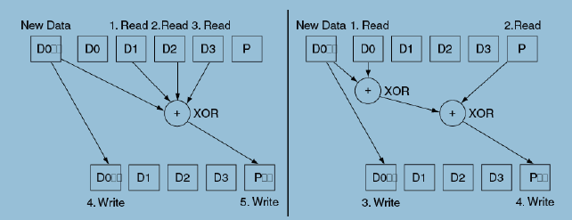
RAID 4
RAID 3
Four data blocks and one parity block
Writing new data to D0 also reads D1, D2 and D3, before adding block D0’ to calculate the new parity P’
RAID 4
Reads the old value D0 and compares it to the new value D0’ to see which bits will change, then read to old parity P and then change the corresponding bit to form P’
‹#›

Slide 56
RAID 5
RAID 4 drawback is that the parity disk must be updated on every write rely on one disk, so in this, the parity information can be spread throughout/distributed on all the disks so that there is no single bottleneck of writes
Small writes can be performed in parallel
‹#›

Slide 57
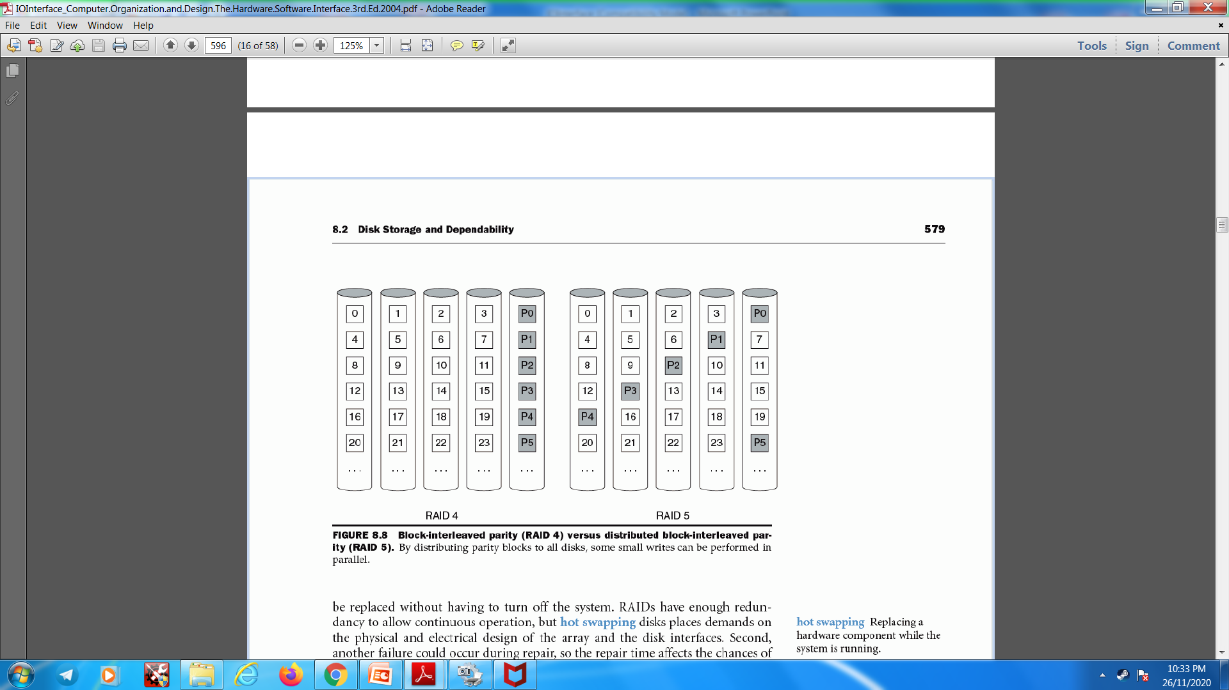
RAID 5
RAID 5
Write to block 8 also access its parity block p2 (Accessing first and third disk) and together to write block 5 its parity block P1 (Accessing second and fourth disk)
RAID 4
‹#›

Slide 58
RAID 6
Upto this, parity based schemes protect against a single self identifying failure
When a single failure correction is not sufficient, parity (P) can be generalized to have second calculation over the data and another check disk (Q) of information to recover from a second failure
The storage overhead is twice than the RAID 5 and writes also increases by 2 (RAID 5: 4) (RAID 6: 6)
Rarely used today
‹#›

Slide 59
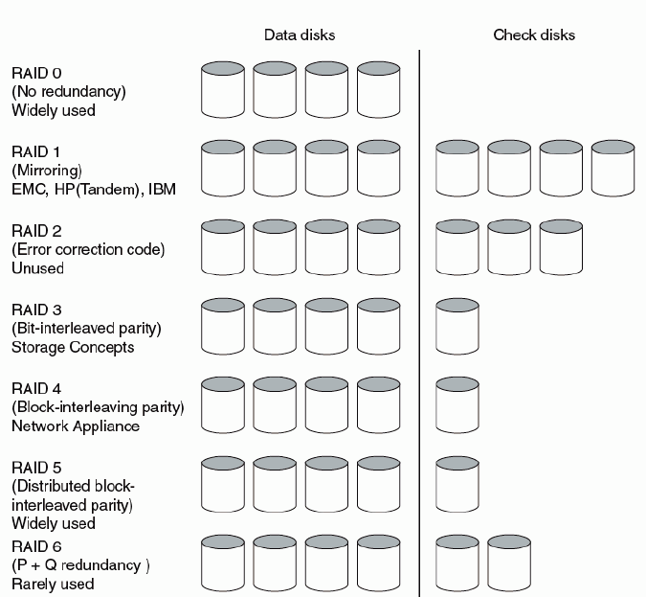
RAID
‹#›

Slide 60
Networks (e.g., the Internet)
When communicating over a network, typically your communication is broken into a collection of “packets”
Each packet carries ~1kB of data
Packets are reassembled into the original message at the destination
‹#›

Slide 61
Network (and I/O) Performance
There are two fundamental performance metrics for I/O systems:
Bandwidth
The amount of data that can be transferred in unit time (units = bytes/time)
This is a primary concern for applications which transfer large amounts of data in big blocks
If you download large files, bandwidth will be the limiting factor
Latency
The time taken for the smallest transfer (units = time)
This is a primary concern for programs that do many small dependent transfers
[
‹#›

Slide 62
Back of the Envelope Calculation
Because the transmission of network packets can be pipelined, the time for a transfer can be estimated as:
Transfer time = latency + transfer_size / bandwidth
= time + bytes / (bytes/time)
Dominant term for
small transfers
Dominant term for
large transfers
‹#›

Slide 63
Example bus problems
I/O problems always start with some assumptions about a system
A CPU and memory share a 32-bit bus running at 100MHz
The memory needs 50ns to access a 64-bit value from one address
Then, questions generally ask about the latency or throughput
How long does it take to read one address of memory?
How many random addresses can be read per second?
You need to find the total time for a single transaction
1. It takes one cycle to send a 32-bit address to the memory
2. The memory needs 50ns, or 5 cycles, to read a 64-bit value
3. It takes two cycles to send 64 bits over a 32-bit wide bus
Then you can calculate latencies and throughputs
The time to read from one address is eight cycles or 80ns
To do 12.5 million reads per second, for an effective bandwidth of (12.5 x 10⁶ reads/second) x (8 bytes/read) = 100MB/s
‹#›

Slide 64
Advanced Topics
‹#›

Slide 65
EXTRA JUST FOR INFORMATION
‹#›

Slide 66
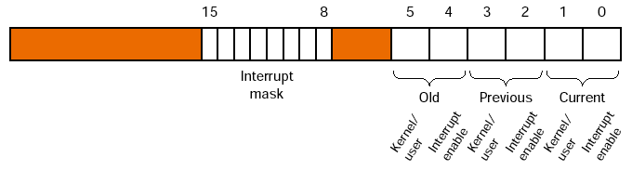
MIPS Interrupt Programming
In order to receive interrupts, the software has to enable them
On a MIPS processor, this is done by writing to the Status register.
Interrupts are enabled by setting bit zero.
MIPS has multiple interrupt levels
Interrupts for different levels can be selectively enabled
To receive an interrupt, it is bit in the interrupt mask (bits 8-15 of the Status register) must be set
In the Figure, interrupt level 15 is enabled
1
1
‹#›

Slide 67
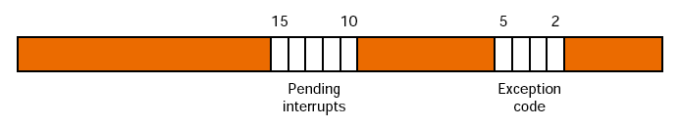
MIPS Interrupt Programming
When an interrupt occurs, the Cause register indicates which one
For an exception, the exception code field holds the exception type
For an interrupt, the exception code field is 0000 and bits will be set for pending interrupts
The register below shows a pending interrupt at level 15
The exception handler is generally part of the operating system
1
0
0
0
0
‹#›

